Slide 1
DSA-20: Introduction to Hashing
Dr. Naveen Kumar
Associate Professor
Amity Institute of Information Technology
Amity University Patna

Slide 2
Hashing Intro
Process of generating a small sized output (that can be used as index in a table) from an input of typically large and variable size.
Hashing uses mathematical formulas known as hash functions to do the transformation.
This technique determines an index or location for the storage of an item in a data structure called Hash Table.

Slide 3
Hash Table Data Structure Overview
Supports search, insert and delete in O(1) time on average which is more efficient than other popular data structures like arrays, Linked List and Self Balancing BST.
Use for dictionaries, frequency counting, maintaining data for quick access by key, etc.
Real World Applications include Database Indexing, Cryptography, Caches, Symbol Table and Dictionaries.

Slide 4
Components of Hashing
Key: A Key can be anything string or integer which is fed as input in the hash function the technique that determines an index or location for storage of an item in a data structure.
Hash Function: Receives the input key and returns the index of an element in an array called a hash table. The index is known as the hash index .
Hash Table: Hash table is typically an array of lists. It stores values corresponding to the keys. Hash stores the data in an associative manner in an array where each data value has its own unique index.

Slide 5
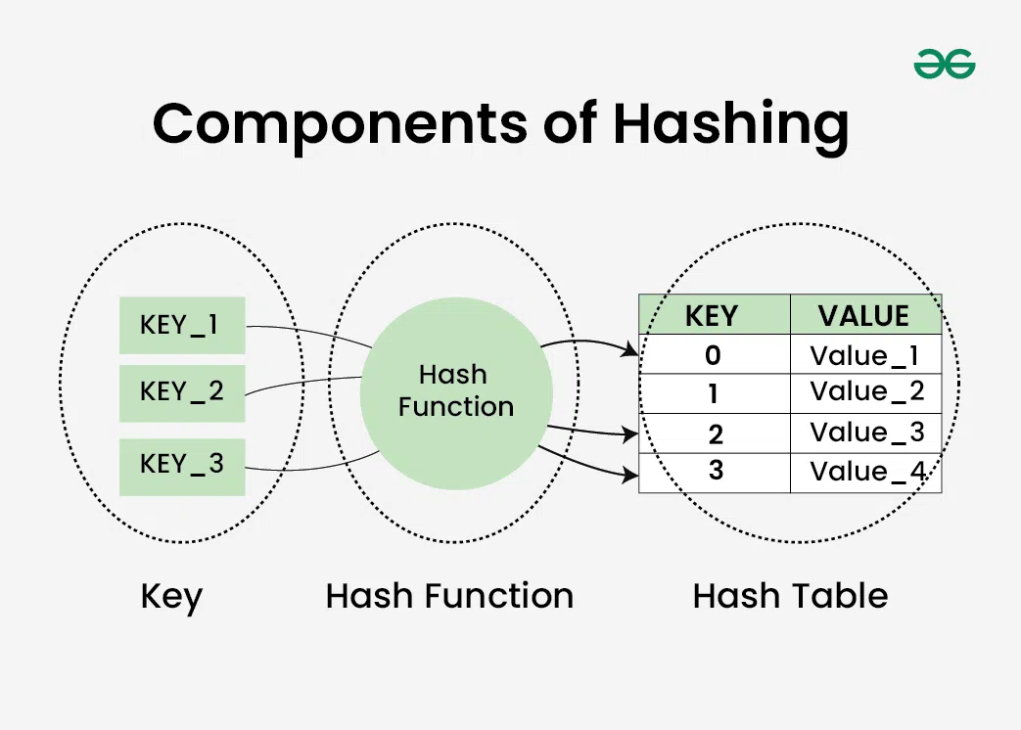

Slide 6
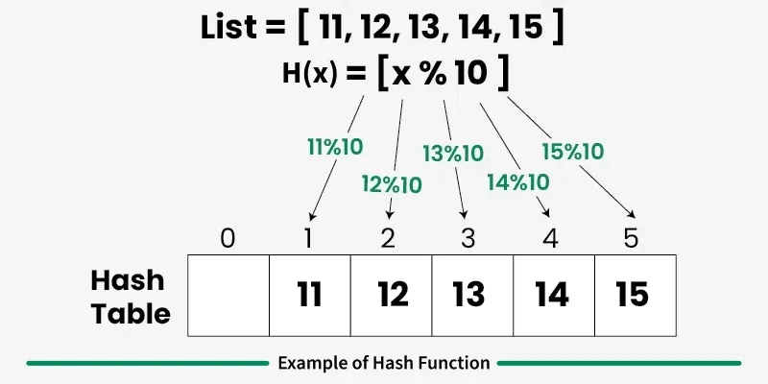
Hash Function
A hash function is a function that takes an input (or key) of arbitrary size and converts it into a fixed-size value, called a hash value or hash code.

Slide 7
Ex1. Phone Numbers as Input Keys
Use the last two digits of the phone number as the hash value.
Hash Function h(k) = k mod 100
The hash table size is 100, so valid indices range from 0 to 99
Taking the last two digits ensures the output always falls within this range
Note: Taking the first two digits is not a good choice because many phone numbers share the same starting digits, leading to poor distribution and more collisions.

Slide 8
Ex2. Lowercase English Strings as Keys
Assign values to characters (a = 1, b = 2, ..., z = 26), sum them, and take modulo.
Hash Function: h(s) = (sum of character values) mod 100
Limitation: Different strings can produce the same hash value:
"ad": 1 + 4 = 5
"bc": 2 + 3 = 5
This leads to collisions.
Improved Approach (Weighted Sum):
Use positional weights for characters to reduce collisions.
Better Hash Function (conceptual): h(s) = (Σ value(s[i]) × weight[i]) mod 100
It is conceptual because the weights are not fixed and can vary.
Each character contributes differently based on its position, improving distribution and reducing collisions.

Slide 9
Properties of Hash Functions
A good hash function should satisfy certain properties to ensure efficient and reliable data storage, retrieval, and security.
Deterministic: A hash function must consistently produce the same output for the same input.
Fixed Output Size: The output of a hash function should have a fixed size, regardless of the size of the input.
Efficiency: The hash function should be able to process input quickly.
Uniformity: The hash function should distribute the hash values uniformly across the output space to avoid clustering.
Pre-image Resistance: It should be computationally infeasible to reverse the hash function, i.e., to find the original input given a hash value.
Collision Resistance: It should be difficult to find two different inputs that produce the same hash value.
Avalanche Effect: A small change in the input should produce a significantly different hash value.

Slide 10
Applications of Hash Functions
Hash functions are widely used across various domains due to their efficiency and versatility:
Hash Tables: The most common use of hash functions in DSA is in hash tables, which provide an efficient way to store and retrieve data.
Data Integrity: Hash functions are used to ensure the integrity of data by generating checksums.
Cryptography: In cryptographic applications, hash functions are used to create secure hash algorithms like SHA-256.
Data Structures: Hash functions are utilized in various data structures such as Bloom filters and hash sets.

Slide 11
Types of Hash Functions
1. Division Method
2. Multiplication Method
3. Mid-Square Method
4. Folding Method
5. Cryptographic Hash Functions
6. Universal Hashing
7. Perfect Hashing

Slide 12
1. Division Method
The division method computes the hash value as the remainder when the key is divided by m, where m is usually chosen as a prime number.
h(k)=k mod m
Where k is the key and m is typically chosen as a prime number.
Advantages:
Simple to implement.
Works well when m is a prime number.
Disadvantages:
Poor distribution if m is not chosen wisely.

Slide 13
2. Multiplication Method
In this method, the key is multiplied by a constant A (where 0 < A < 1). The fractional part of the result is then multiplied by m to obtain the hash value.
h(k)=⌊m * ((k * A) mod 1)⌋
Where ⌊ ⌋ denotes the floor function.
Unlike the division method, this technique is less dependent on the value of m, making it more flexible in practice.
Advantages:
Provides better distribution in many cases.
Less sensitive to table size.
Disadvantages:
Slightly more complex to compute.

Slide 14
3. Mid-Square Method
This method involves squaring the key and extracting the middle portion of the result to generate the hash value.
Steps:
Square the key.
Extract the middle digits of the squared value.
Squaring the key helps in spreading out the digits, which often results in a more uniform distribution of hash values.
Advantages:
Produces a good distribution of hash values.
Disadvantages:
May require more computational effort.

Slide 15
4. Folding Method
In the folding method, the key is divided into several smaller parts, and these parts are combined (usually by addition) to generate the hash value.
Steps:
Split the key into equal or nearly equal segments.
Add all the segments to obtain an intermediate sum.
Apply modulo operation (if required) to fit the hash table size.
Optionally, reverse alternate segments before adding to improve distribution.
Advantages:
Simple and easy to implement.
Works well for large keys.
Flexible in partitioning strategy.
Disadvantages:
Quality depends on how the key is divided.
May not distribute values uniformly if parts are similar.

Slide 16
5. Cryptographic Hash Functions
These hash functions are designed for security rather than speed. They are used in applications where data protection is critical.
Examples include SHA-256 and SHA-3, which are widely used in security applications like password hashing and blockchain.
They ensure strong properties like pre-image resistance, second pre-image resistance, and collision resistance, making them suitable for secure systems.
Advantages:
Highly secure and reliable.
Disadvantages:
Slower compared to non-cryptographic hash functions.

Slide 17
6. Universal Hashing
Universal hashing uses a set of hash functions and selects one randomly at runtime. The goal is to minimize the probability of collisions regardless of the input distribution.
h(k)=((a * k + b) mod p) mod m
Where a and b are randomly chosen constants, p is a prime number greater than m, and k is the key.
By introducing randomness, this method prevents attackers or worst-case inputs from degrading performance.
Advantages:
Reduces collision probability.
More robust against adversarial inputs.
Disadvantages:
Requires more computation and storage.

Slide 18
7. Perfect Hashing
Perfect hashing is a technique used to construct a hash function for a fixed set of keys, ensuring that each key maps to a unique index with no collisions.
Perfect hashing is commonly classified into two main types:
Minimal Perfect Hashing: Ensures that the range of the hash function is equal to the number of keys.
Non-minimal Perfect Hashing: The range may be larger than the number of keys.
Advantages:
Eliminates collisions completely.
Disadvantages:
Difficult to construct.
Not suitable for dynamic data.

Slide 19
Collision Resolution Techniques
The hash function may return the same hash value for two or more keys. This creates collision that needs to be handled.
We use Collision Resolution Techniques.
Collision Resolution Techniques
There are mainly two methods to handle collision:
Separate Chaining
Open Addressing

Slide 20
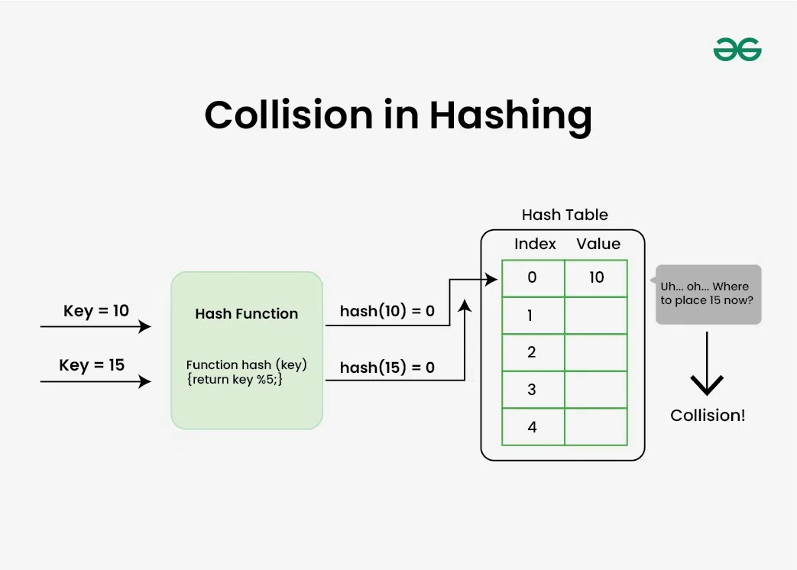

Slide 21
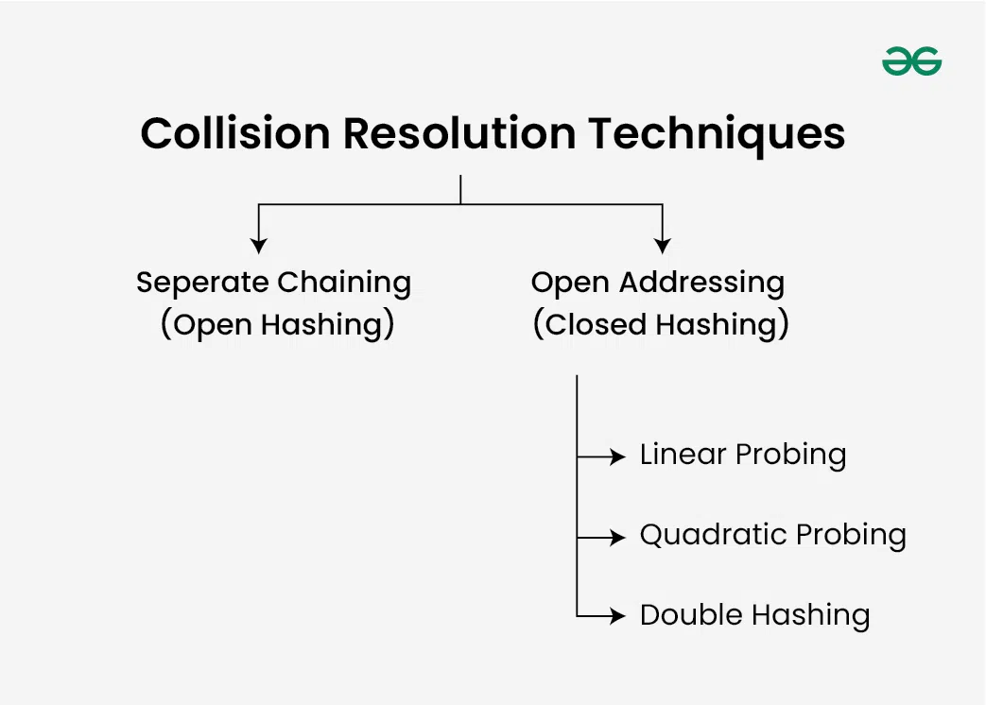

Slide 22
Hashing with Chaining Implementation
To insert a node into the hash table, we first compute the hash index for the given key using a hash function:
hashIndex = key % noOfBuckets.
This index determines the appropriate bucket where the node should be inserted.
Example: noOfBuckets = 7 keys to insert = [15, 11, 27, 8]
For each key:
15 % 7 = 1
11 % 7 = 4
27 % 7 = 6
8 % 7 = 1

Slide 23
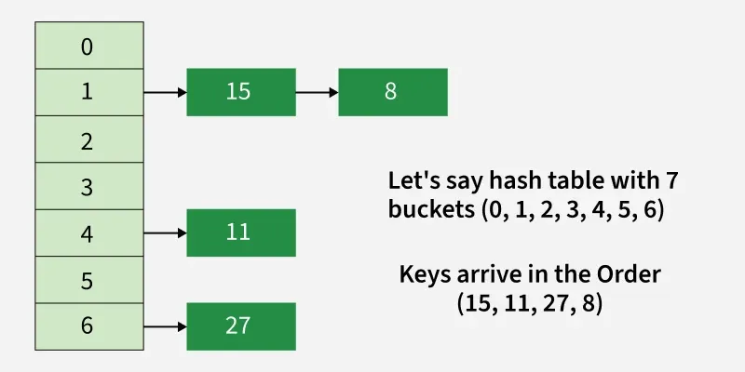

Slide 24
Simple Chaining
This method has not concept of rehashing. It only has a fixed size array i.e. fixed numbers of buckets.

Slide 25
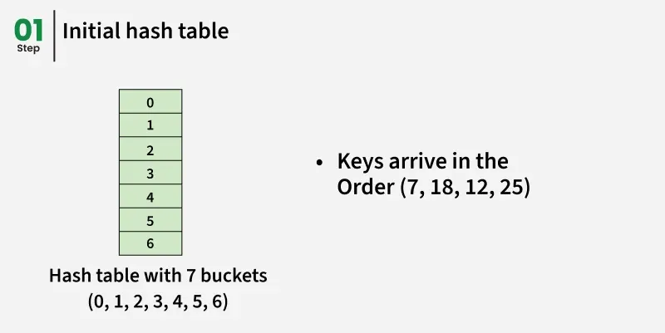

Slide 26
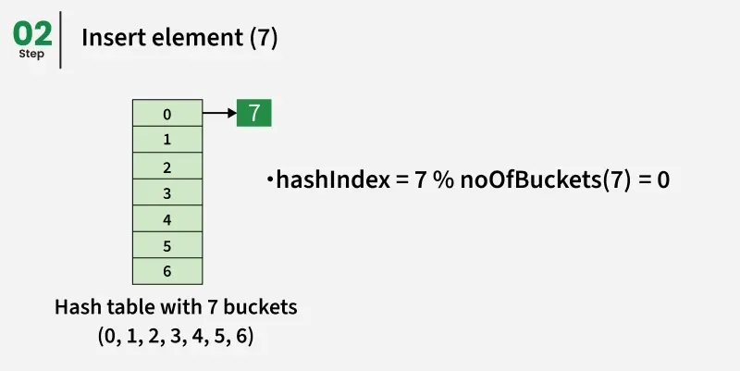

Slide 27
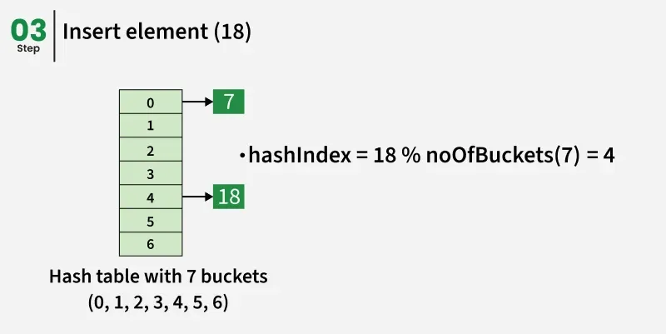

Slide 28
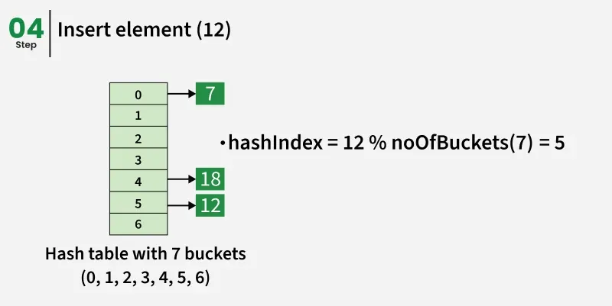

Slide 29
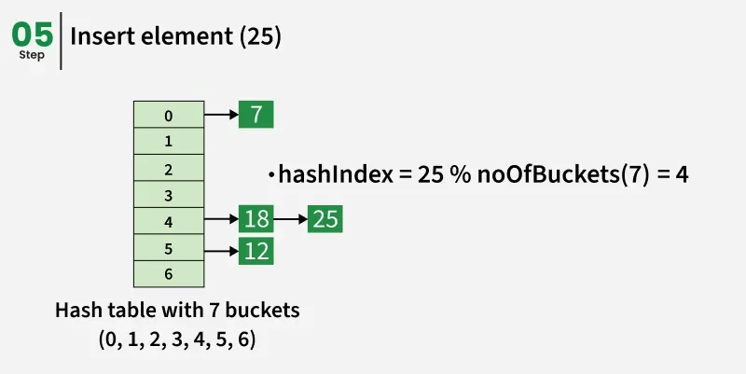

Slide 30
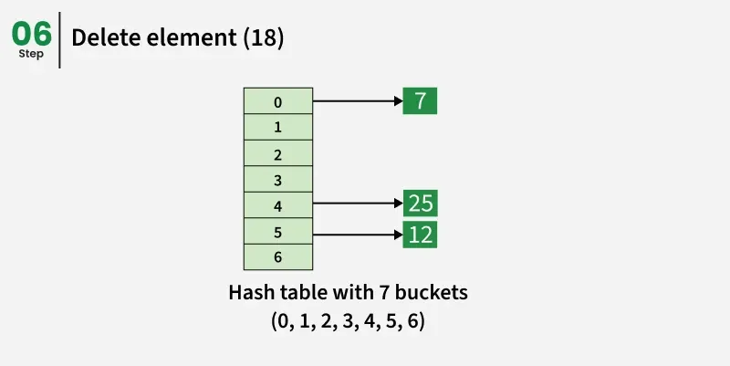

Slide 31
1) Separate Chaining
Each cell of the hash table point to a linked list of records that have the same hash function value. Chaining is simple but requires additional memory outside the table.
Example: We have given a hash function and we have to insert some elements in the hash table using a separate chaining method for collision resolution technique.
Hash function = key % 5, Elements = 12, 15, 22, 25 and 37.

Slide 32
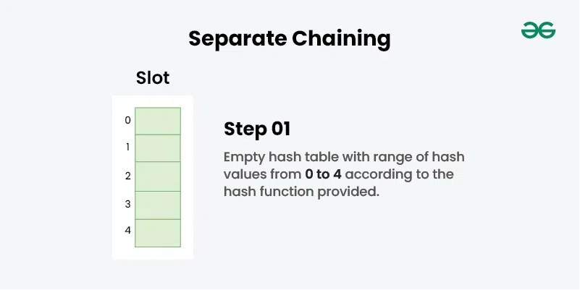

Slide 33
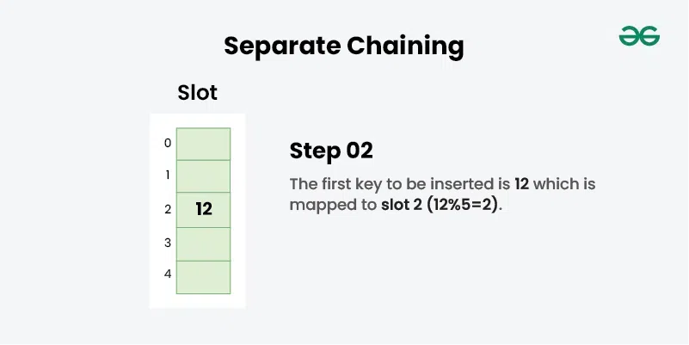

Slide 34
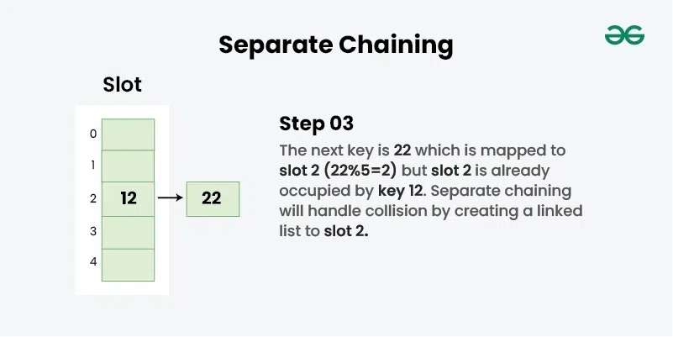

Slide 35
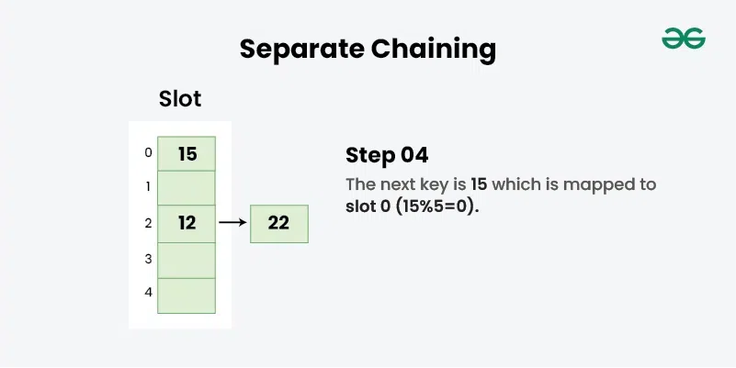

Slide 36
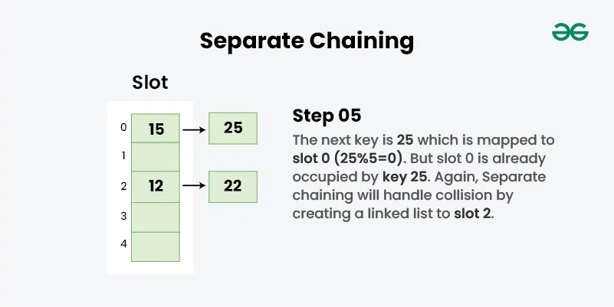

Slide 37
Insert: Move to the bucket corresponding to the above-calculated hash index and insert the new node at the end of the list. Delete: To delete a node from hash table, calculate the hash index for the key, move to the bucket corresponding to the calculated hash index, and search the list in the current bucket to find and remove the node with the given key (if found).

